Slide 1
MapReduce (YARN)
MapReduce 2.0 (MRv2)
MapReduce has undergone a complete overhaul in hadoop-0.23.

Slide 2
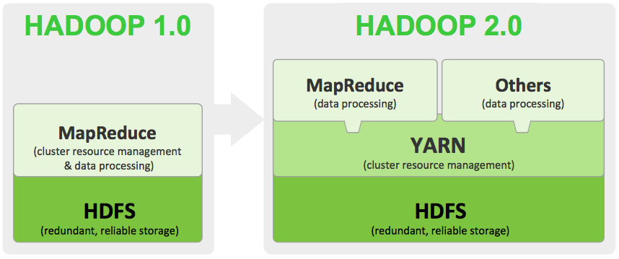
YARN it !

Slide 3
What is YARN ?
The fundamental idea of MRv2 is to split up the two major functionalities of the JobTracker, resource management and job scheduling/monitoring, into separate daemons.
The idea is to have a global ResourceManager (RM) and per-application ApplicationMaster (AM).
An application is either a single job in the classical sense of Map-Reduce jobs or a DAG of jobs.
Notes:
Directed Acyclic Graph- A collection of tasks that must be ordered into a sequence, subject to constraints that certain tasks must be performed earlier than others, may be represented as a DAG with a vertex for each task and an edge for each constraint; algorithms for topological ordering may be used to generate a valid sequence. DAGs may also be used to model processes in which data flows in a consistent direction through a network of processors.

Slide 4
What is YARN ?
The new architecture divides the two major functions of the JobTracker – resource management and job life-cycle management – into separate components:
A ResourceManager (RM) that manages the global assignment of compute resources to applications.
A per-application ApplicationMaster (AM) that manages the application’s life cycle.
# In Hadoop 0.23, a MapReduce application is a single job in the sense of classic MapReduce, executed by the MapReduce ApplicationMaster.

Slide 5
Job Tracker is combination of RM and AM what about Task Tracker(MRv1) ?
There is also a per-machine NodeManager (NM) that manages the user processes on that machine.
The RM and the NM form the computation fabric of the cluster.
For application specific long-running auxiliary services that are plugged with NM is part of configuration, and loaded by the NM during startup.
For MapReduce applications on YARN, shuffle is a typical auxiliary service loaded by the NMs.
Notes:
RM – Resource Manager
NM – Node Manager
# in Hadoop versions prior to 0.23, shuffle was part of the TaskTracker.

Slide 6
How RM , AM and NM work together?
The per-application ApplicationMaster is a framework specific library and is tasked with negotiating resources from the ResourceManager and working with the NodeManager(s) to execute and monitor the tasks.

Slide 7
Think beyond MapReduce !
In the YARN design, MapReduce is just one application framework; the design permits building and deploying distributed applications using other frameworks as well.
For example, Hadoop 0.23 ships with a Distributed Shell application that permits running a shell script on multiple nodes on the YARN cluster. Possibility is even for Message Passing Interface (MPI) applications on top of YARN.

Slide 8
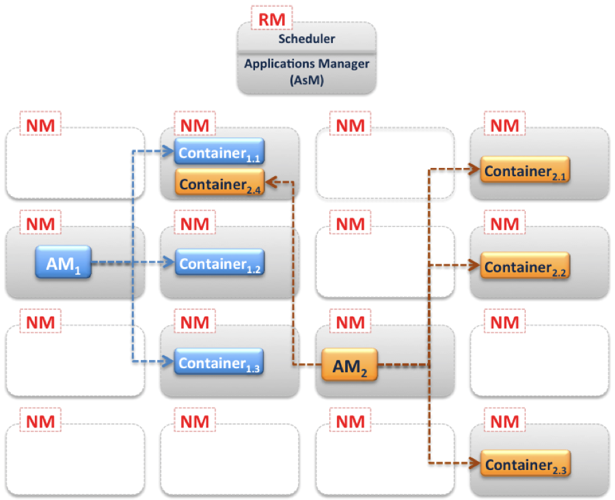
MapReduce 2.0 Design
Figure 1
Notes:
Figure 1 shows a pictorial representation of a YARN cluster. There is a single Resource Manager, which has two main services:
A pluggable Scheduler, which manages and enforces the resource scheduling policy in the cluster. Note that there are two schedulers supported in Hadoop 0.23, the default FIFO scheduler and the Capacity scheduler; the Fair Scheduler is not yet supported.
An Applications Manager (AsM), which manages running Application Masters in the cluster, i.e., it is responsible for starting application masters and for monitoring and restarting them on different nodes in case of failures.
Figure 1 also shows that there is a NM service running on each node in the cluster. The diagram also shows two AMs (AM₁ and AM₂). In a YARN cluster at any given time, there will be as many running Application Masters as there are applications (jobs). Each AM manages the application’s individual tasks (starting, monitoring and restarting in case of failures). The diagram shows AM₁ managing three tasks (containers 1.1, 1.2 and 1.3), while AM₂ manages four tasks (containers 2.1, 2.2, 2.3 and 2.4). Each task runs within a Container on each node. The AM acquires such containers from the RM’s Scheduler before contacting the corresponding NMs to start the application’s individual tasks. These Containers can be roughly compared to Map/Reduce slots in previous Hadoop versions. However the resource allocation model in Hadoop-0.23 is more optimized from a cluster utilization perspective.

Slide 9
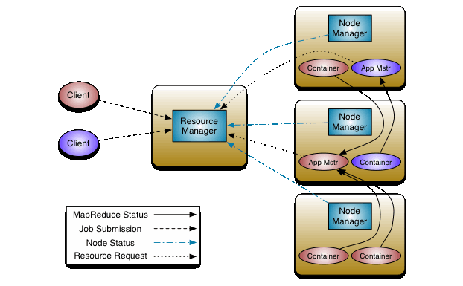
MapReduce 2.0 Design
Figure 2
Notes:
The ResourceManager has two main components: Scheduler and ApplicationsManager.
The Scheduler is responsible for allocating resources to the various running applications subject to familiar constraints of capacities, queues etc. The Scheduler is pure scheduler in the sense that it performs no monitoring or tracking of status for the application. Also, it offers no guarantees about restarting failed tasks either due to application failure or hardware failures. The Scheduler performs its scheduling function based the resource requirements of the applications; it does so based on the abstract notion of a resource Container which incorporates elements such as memory, cpu, disk, network etc. In the first version, only memory is supported.
The Scheduler has a pluggable policy plug-in, which is responsible for partitioning the cluster resources among the various queues, applications etc. The current Map-Reduce schedulers such as the CapacityScheduler and the FairScheduler would be some examples of the plug-in.
The CapacityScheduler supports hierarchical queues to allow for more predictable sharing of cluster resources
The ApplicationsManager is responsible for accepting job-submissions, negotiating the first container for executing the application specific ApplicationMaster and provides the service for restarting the ApplicationMaster container on failure.
The NodeManager is the per-machine framework agent who is responsible for containers, monitoring their resource usage (cpu, memory, disk, network) and reporting the same to the ResourceManager/Scheduler.
The per-application ApplicationMaster has the responsibility of negotiating appropriate resource containers from the Scheduler, tracking their status and monitoring for progress.
MRV2 maintains API compatibility with previous stable release (hadoop-0.20.205). This means that all Map-Reduce jobs should still run unchanged on top of MRv2 with just a recompile.

Slide 10
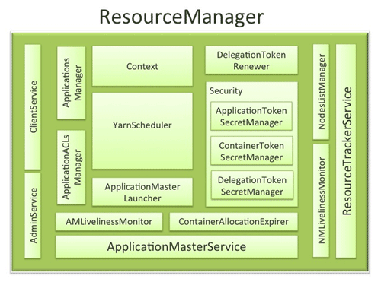
Resource Manager
Notes:
ResourceManager (RM) is the master that arbitrates all the available cluster resources and thus helps manage the distributed applications running on the YARN system. It works together with the per-node NodeManagers (NMs) and the per-application ApplicationMasters (AMs).
NodeManagers take instructions from the ResourceManager and manage resources available on a single node.
ApplicationMasters are responsible for negotiating resources with the ResourceManager and for working with the NodeManagers to start the containers.

Slide 11
Resource Manager Components
Components interfacing RM to the clients
ClientService
AdminService
Components connecting RM to the nodes
ResourceTrackerService
NMLivelinessMonitor
NodesListManager
Components interacting with the per-application AMs
ApplicationMasterService
AMLivelinessMonitor
The core of the ResourceManager : the scheduler and related components
ApplicationsManager
ApplicationACLsManager
ApplicationMasterLauncher
YarnScheduler
ContainerAllocationExpirer
TokenSecretManagers (for security)
ApplicationTokenSecretManager
ContainerTokenSecretManager
RMDelegationTokenSecretManager
DelegationTokenRenewer

Slide 12
Components interfacing RM to the clients:
ClientService:
The client interface to the Resource Manager. This component handles all the RPC interfaces to the RM from the clients including operations like application submission, application termination, obtaining queue information, cluster statistics etc.
AdminService:
To make sure that admin requests don’t get starved due to the normal users’ requests and to give the operators’ commands the higher priority, all the admin operations like refreshing node-list, the queues’ configuration etc. are served via this separate interface.

Slide 13
Components connecting RM to the nodes:
ResourceTrackerService:
This is the component that responds to RPCs from all the nodes. It is responsible for registration of new nodes, rejecting requests from any invalid/decommissioned nodes, obtain node-heartbeats and forward them over to the YarnScheduler. It works closely with NMLivelinessMonitor and NodesListManager described below.
NMLivelinessMonitor:
To keep track of live nodes and specifically note down the dead nodes, this component keeps track of each node’s its last heartbeat time. Any node that doesn’t heartbeat within a configured interval of time, by default 10 minutes, is deemed dead and is expired by the RM. All the containers currently running on an expired node are marked as dead and no new containers are scheduling on such node.

Slide 14
Components connecting RM to the nodes:
NodesListManager: A collection of valid and excluded nodes. Responsible for reading the host configuration files specified via yarn.resourcemanager.nodes.include-path and yarn.resourcemanager.nodes.exclude-path and seeding the initial list of nodes based on those files. Also keeps track of nodes that are decommissioned as time progresses.

Slide 15
Components connecting RM to the nodes:
NodesListManager:
A collection of valid and excluded nodes. Responsible for reading the host configuration files specified via yarn.resourcemanager.nodes.include-path and yarn.resourcemanager.nodes.exclude-path and seeding the initial list of nodes based on those files. Also keeps track of nodes that are decommissioned as time progresses.

Slide 16
Components interacting with the per-application AMs
ApplicationMasterService:
This is the component that responds to RPCs from all the AMs.
It is responsible for registration of new AMs, termination/unregister-requests from any finishing AMs, obtaining container-allocation & deallocation requests from all running AMs and forward them over to the YarnScheduler.
This works closely with AMLivelinessMonitor described below.

Slide 17
Components interacting with the per-application AMs
AMLivelinessMonitor:
To help manage the list of live AMs and dead/non-responding AMs, this component keeps track of each AM and its last heartbeat time.
Any AM that doesn’t heartbeat within a configured interval of time, by default 10 minutes, is deemed dead and is expired by the RM. All the containers currently running/allocated to an AM that gets expired are marked as dead.
RM schedules the same AM to run on a new container, allowing up to a maximum of 4 such attempts by default.

Slide 18
The core of the ResourceManager – the scheduler and related components
ApplicationsManager:
Responsible for maintaining a collection of submitted applications.
Keeps a cache of completed applications so as to serve users’ requests via web UI or command line long after the applications in question finished.
ApplicationMasterLauncher:
Maintains a thread-pool to launch AMs of newly submitted applications as well as applications whose previous AM attempts exited due to some reason.
Also responsible for cleaning up the AM when an application has finished normally or forcefully terminated.
ContainerAllocationExpirer: This component is in charge of ensuring that all allocated containers are used by AMs and subsequently launched on the correspond NMs. AMs run as untrusted user code and can potentially hold on to allocations without using them, and as such can cause cluster under-utilization. To address this, ContainerAllocationExpirer maintains the list of allocated containers that are still not used on the corresponding NMs. For any container, if the corresponding NM doesn’t report to the RM that the container has started running within a configured interval of time, by default 10 minutes, the container is deemed as dead and is expired by the RM.

Slide 19
The core of the ResourceManager – the scheduler and related components
ApplicationACLsManager:
RM needs to gate the user facing APIs like the client and admin requests to be accessible only to authorized users. This component maintains the ACLs lists per application and enforces them whenever an request like killing an application, viewing an application status is received.

Slide 20
The core of the ResourceManager – the scheduler and related components
YarnScheduler:
The Scheduler is responsible for allocating resources to the various running applications subject to constraints of capacities, queues etc. It performs its scheduling function based on the resource requirements of the applications such as memory, CPU, disk, network etc. Currently, only memory is supported and support for CPU is close to completion.

Slide 21
The core of the ResourceManager – the scheduler and related components
ContainerAllocationExpirer:
This component is in charge of ensuring that all allocated containers are used by AMs and subsequently launched on the correspond NMs. AMs run as untrusted user code and can potentially hold on to allocations without using them, and as such can cause cluster under-utilization. To address this, ContainerAllocationExpirer maintains the list of allocated containers that are still not used on the corresponding NMs. For any container, if the corresponding NM doesn’t report to the RM that the container has started running within a configured interval of time, by default 10 minutes, the container is deemed as dead and is expired by the RM.

Slide 22
TokenSecretManagers (for security)
ResourceManager has a collection of SecretManagers which are charged with managing tokens, secret-keys that are used to authenticate/authorize requests on various RPC interfaces.
A future post on YARN security will cover a more detailed descriptions of the tokens, secret-keys and the secret-managers but a brief summary follows:
ApplicationTokenSecretManager
ContainerTokenSecretManager
RMDelegationTokenSecretManager
Notes:
ApplicationTokenSecretManager: To avoid arbitrary processes from sending RM scheduling requests, RM uses the per-application tokens called ApplicationTokens. This component saves each token locally in memory till application finishes and uses it to authenticate any request coming from a valid AM process.
ContainerTokenSecretManager: SecretManager for ContainerTokens that are special tokens issued by RM to an AM for a container on a specific node. ContainerTokens are used by AMs to create a connection to the corresponding NM where the container is allocated. This component is RM-specific, keeps track of the underlying master and secret-keys and rolls the keys every so often.
RMDelegationTokenSecretManager: A ResourceManager specific delegation-token secret-manager. It is responsible for generating delegation tokens to clients which can be passed on to unauthenticated processes that wish to be able to talk to RM.

Slide 23
DelegationTokenRenewer:
In secure mode, RM is Kerberos authenticated and so provides the service of renewing file-system tokens on behalf of the applications. This component renews tokens of submitted applications as long as the application runs and till the tokens can no longer be renewed.

Slide 24
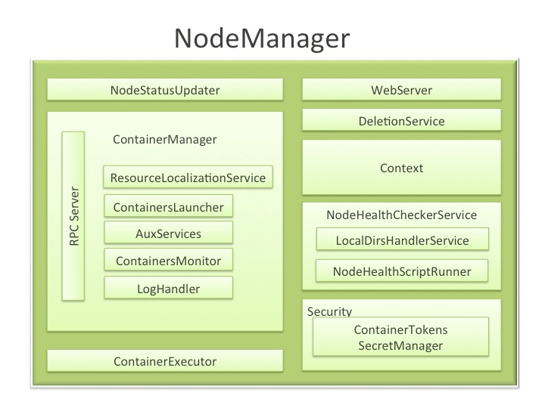
Node Manager

Slide 25
NodeManager Components
NodeStatusUpdater
ContainerManager
RPC server
ResourceLocalizationService
ContainersLauncher
AuxServices
ContainersMonitor
LogHandler
ContainerExecutor
NodeHealthCheckerService
Security
ApplicationACLsManager
ContainerTokenSecretManager
WebServer

Slide 26
NodeStatusUpdater
On startup, this component registers with the RM and sends information about the resources available on the nodes. Subsequent NM-RM communication is to provide updates on container statuses – new containers running on the node, completed containers, etc.
In addition the RM may signal the NodeStatusUpdater to potentially kill already running containers.

Slide 27
ContainerManager
This is the core of the NodeManager. It is composed of the following sub-components, each of which performs a subset of the functionality that is needed to manage containers running on the node.
RPC server
ResourceLocalizationService
ContainersLauncher
AuxServices
ContainersMonitor
LogHandler
Notes:
RPC server: ContainerManager accepts requests from Application Masters (AMs) to start new containers, or to stop running ones. It works with ContainerTokenSecretManager (described below) to authorize all requests. All the operations performed on containers running on this node are written to an audit-log which can be post-processed by security tools.
ResourceLocalizationService: Responsible for securely downloading and organizing various file resources needed by containers. It tries its best to distribute the files across all the available disks. It also enforces access control restrictions of the downloaded files and puts appropriate usage limits on them.
ContainersLauncher: Maintains a pool of threads to prepare and launch containers as quickly as possible. Also cleans up the containers’ processes when such a request is sent by the RM or the ApplicationMasters (AMs).
AuxServices: The NM provides a framework for extending its functionality by configuring auxiliary services. This allows per-node custom services that specific frameworks may require, and still sandbox them from the rest of the NM. These services have to be configured before NM starts. Auxiliary services are notified when an application’s first container starts on the node, and when the application is considered to be complete.
ContainersMonitor: After a container is launched, this component starts observing its resource utilization while the container is running. To enforce isolation and fair sharing of resources like memory, each container is allocated some amount of such a resource by the RM. The ContainersMonitor monitors each container’s usage continuously and if a container exceeds its allocation, it signals the container to be killed. This is done to prevent any runaway container from adversely affecting other well-behaved containers running on the same node.
LogHandler: A pluggable component with the option of either keeping the containers’ logs on the local disks or zipping them together and uploading them onto a file-system.

Slide 28
ContainerExecutor
Interacts with the underlying operating system to securely place files and directories needed by containers and subsequently to launch and clean up processes corresponding to containers in a secure manner.
NodeHealthCheckerService
Provides functionality of checking the health of the node by running a configured script frequently. It also monitors the health of the disks specifically by creating temporary files on the disks every so often. Any changes in the health of the system are notified to NodeStatusUpdater (described above) which in turn passes on the information to the RM.

Slide 29
Security
ApplicationACLsManager :
NM needs to gate the user facing APIs like container-logs’ display on the web-UI to be accessible only to authorized users. This component maintains the ACLs lists per application and enforces them whenever such a request is received.
ContainerTokenSecretManager:
verifies various incoming requests to ensure that all the incoming operations are indeed properly authorized by the RM.

Slide 30
WebServer
Exposes the list of applications, containers running on the node at a given point of time, node-health related information and the logs produced by the containers.

Slide 31
Scheduler
The Scheduler is responsible for allocating resources to the various running applications subject to familiar constraints of capacities, queues etc.
Pure scheduler in the sense that it performs no monitoring or tracking of status for the application.
Also, it offers no guarantees about restarting failed tasks either due to application failure or hardware failures.
It performs its scheduling function based the resource requirements of the applications; it does so based on the abstract notion of a resource Container which incorporates elements such as memory, cpu, disk, network etc. In the first version, only memory is supported.

Slide 32
Resource Allocation Model:
How it was ?
Each node in the cluster was statically assigned the capability of running a predefined number of Map slots and a predefined number of Reduce slots.
The slots could not be shared between Maps and Reduces. This static allocation of slots wasn’t optimal since slot requirements vary during the MR job life cycle (typically, there is a demand for Map slots when the job starts, as opposed to the need for Reduce slots towards the end).
Practically, in a real cluster, where jobs are randomly submitted and each has its own Map/Reduce slots requirement, having an optimal utilization of the cluster was hard, if not impossible.
How is it Now?
The resource allocation model in Hadoop 0.23 addresses such deficiency by providing a more flexible resource modeling.
Resources are requested in the form of containers, where each container has a number of non-static attributes.
In this new Resource Management model, only a minimum and a maximum for each attribute are defined, and AMs can request containers with attribute values as multiples of these minimums.

Slide 33
MapReduce 2.0 Main Components and their interaction to each other
Client – Resource Manager
Resource Manager – Application Master
Application Master – Container Manager(Node Manager)
#would be explained in detail in coming slides…

Slide 34
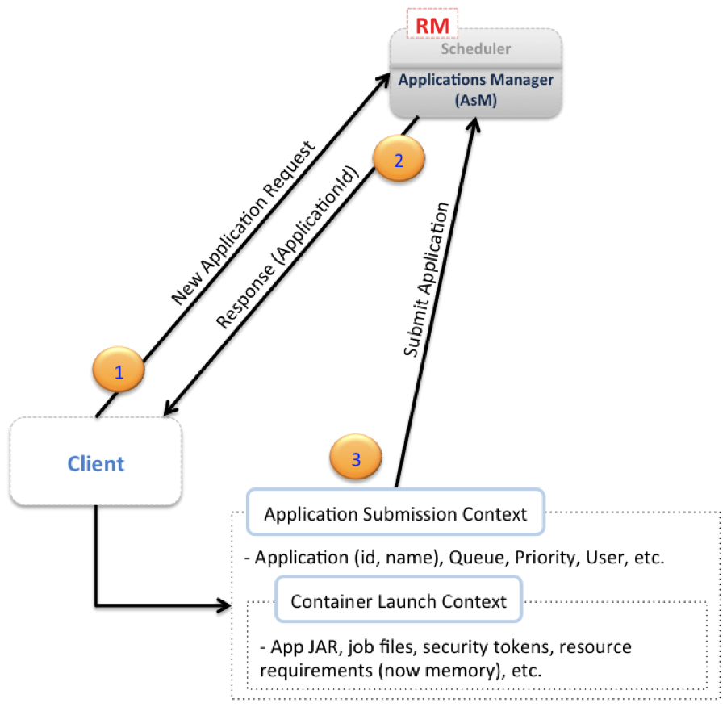
Client – Resource Manager
#Client interacts specifically the Applications Manager component of the RM)
Notes:
Figure illustrates the initial step for running an application on a YARN cluster. Typically a client communicates with the RM (specifically the Applications Manager component of the RM) to initiates this process.
The first step, marked (1) in the diagram, is for the client to notify the Applications Manager of the desire of submitting an application, this is done via a “New Application Request”. The RM response, marked (2), will typically contain a newly generated unique application ID, in addition to information about cluster resource capabilities that the client will need in requesting resources for running the application’s AM.
Using the information received from the RM, the client can construct and submit an “Application Submission Context”, marked (3), which typically contains information like scheduler queue, priority and user information, in addition to information needed by the RM to be able to launch the AM. This information is contained in a “Container Launch Context”, which contains the application’s jar, job files, security tokens and any resource requirements.

Slide 35
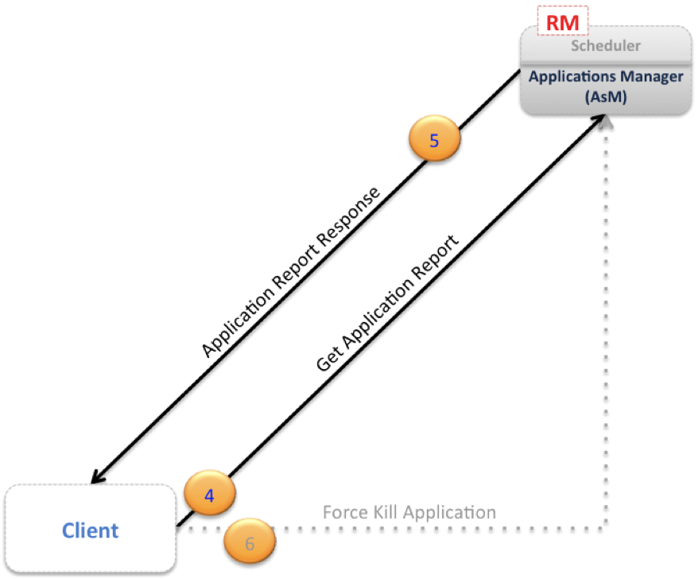
Client – Resource Manager
Figure 4
Notes:
Following application submission, the client can query the RM for application reports, receive such reports and, if needed, the client can also ask the RM to kill the application. These three additional steps are pictorially depicted in fig. 3.

Slide 36
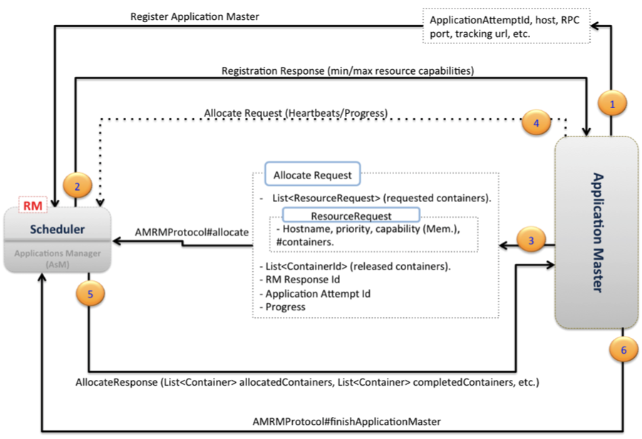
Resource Manager – Application Master
# Communication steps between the AM and the RM (specifically the Scheduler component of the RM).
Figure 5
Notes:
When the RM receives the application submission context from the client, it finds an available container meeting the resource requirements for running the AM, and it contacts the NM for the container to start the AM process on this node.
Figure 4 depicts the following communication steps between the AM and the RM (specifically the Scheduler component of the RM). The first step, marked (1) in the diagram, is for the AM to register itself with the RM. This step consists of a handshaking procedure and also conveys information like the RPC port that the AM will be listening on, the tracking URL for monitoring the application’s status and progress, etc.
The RM registration response, marked (2), will convey essential information for the AM master like minimum and maximum resource capabilities for this cluster. The AM will use such information in calculating and requesting any resource requests for the application’s individual tasks. The resource allocation request from the AM to the RM, marked (3), mainly contains a list of requested containers, and may also contain a list of released containers by this AM.
Heartbeat and progress information are also relayed through resource allocation requests as shown by arrow (4).
When the Scheduler component of the RM receives a resource allocation request, it computes, based on the scheduling policy, a list of containers that satisfy the request and sends back an allocation response, marked (5), which contains a list of allocated resources. Using the resource list, the AM starts contacting the associated node managers (as will be soon seen), and finally, as depicted by arrow (6), when the job finishes, the AM sends a Finish Application message to the Resource Manager and exits.

Slide 37
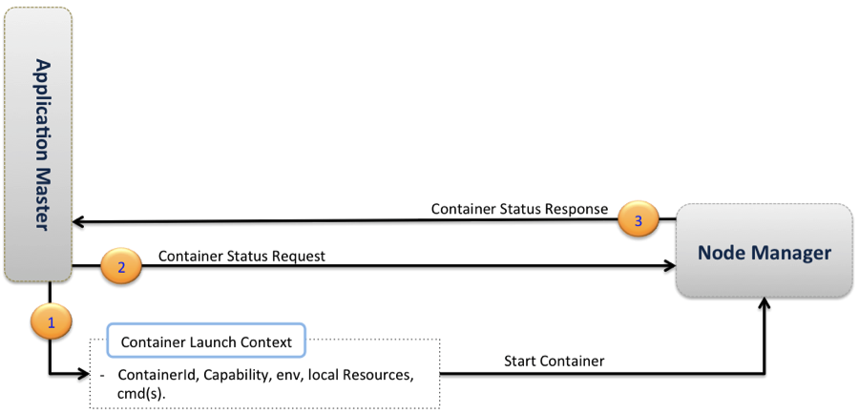
Application Master – Container Manager(Node Manager)
Figure 6
Notes:
Figure 5 describes the communication between the AM and the Node Managers. The AM requests the hosting NM for each container to start it as depicted by arrow (1) in the diagram. While containers are running, the AM can request and receive a container status report as shown in steps (2) and (3), respectively.

Slide 38
Communication Protocols:
ClientRMProtocol: Client RM (Fig. 4). This is the protocol for a client to communicate with the RM to launch a new application (i.e. an AM), check on the status of the application or kill the application.
AMRMProtocol: AM RM (Fig. 5). This is the protocol used by the AM to register/unregister itself with the RM, as well as to request resources from the RM Scheduler to run its tasks.
ContainerManager: AM NM (Fig. 6). This is the protocol used by the AM to communicate with the NM to start or stop containers and to get status updates on its containers.

Slide 39
Migrating older MapReduce applications to run on Hadoop 0.23:
All client-facing MapReduce interfaces are unchanged, which means that there is no need to make any source code changes to run on top of Hadoop 0.23.

Slide 40
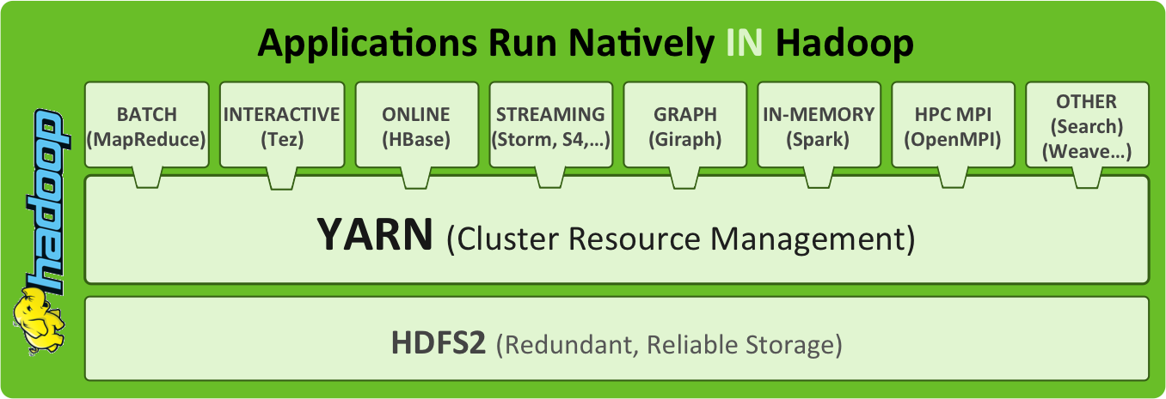
YARN Supports:

Slide 41
YARN Supports:
Applications written (or being ported to run) on top of YARN i.e. Next Generation Hadoop processing framework aka NextGenMapReduce.
Apache Hadoop MapReduce, of course! - https://issues.apache.org/jira/browse/MAPREDUCE-279
Spark - https://github.com/mesos/spark-yarn/
Apache HAMA - https://issues.apache.org/jira/browse/HAMA-431
Apache Giraph - https://issues.apache.org/jira/browse/GIRAPH-13
Open MPI - https://issues.apache.org/jira/browse/MAPREDUCE-2911
Generic Co-Processors for Apache HBase - https://issues.apache.org/jira/browse/HBASE-4047
Other ideas:
Apache HBase deployment using YARN - https://issues.apache.org/jira/browse/HBASE-4329

Slide 42
Further Knowledge Resources:
http://hadoop.apache.org/docs/current/hadoop-yarn/hadoop-yarn-site/WritingYarnApplications.html
http://developer.yahoo.com/blogs/hadoop/next-generation-apache-hadoop-mapreduce-scheduler-4141.html
http://wiki.apache.org/hadoop/WritingYarnApps
http://hortonworks.com/blog/introducing-apache-hadoop-yarn/

